Slide 1
Janette Toral
@digitalfilipino
Facebook.com/janettectoral

Slide 2
1993

Slide 3
Ateneo de Manila University used 9600bps modem in 1993
With the connection of the Ateneo with Victoria University of Technology, it acted as a local hub for campuses like UP, UST, and DLSU.
http://www.admu.edu.ph/news/features/ateneans-connecting-world-part-2-2-series-celebration-20th-year-philippine-internet

Slide 4
Ateneo connecting online
Phase 1: Dial up Internet,
Phase 2: Actual 64kbps connection to the Internet (in 1994) and initial campus network,
Phase 3: Campus network upgrades (1998) and formation of the Campus Network Group, and finally,
Phase 4: Internet in Ateneo moving forward (from 2002 onwards).
http://www.admu.edu.ph/news/features/ateneans-connecting-world-part-1-2-series-celebration-20th-year-philippine-internet

Slide 5
2003

Slide 6
DigitalFilipino StatsReport
23% of postpaid Internet accounts in the country are running on broadband with PLDT leading in the survey. On the dial-up postpaid Internet account, PLDT and Globe are on neck-to-neck with equal share.
http://digitalfilipino.com/the-filipino-internet-user-report-part-2/

Slide 7
2006

Slide 8
Globe 3G Mobile Broadband / PLDT WeRoam 3G

Slide 9
2009

Slide 12
2010

Slide 14
PLDT TelPad

Slide 15
2011

Slide 16
2012

Slide 17
The Philippines only has 123,690.5 Mbits per second of international bandwidth per internet user, which refers to the capacity of all Internet exchanges that backbone operators in the country provide to carry traffic.
At 547,064 Mbits per second, Singapore has the world's fastest Internet and ranks in 11th place on the global list.
http://www.abs-cbnnews.com/-depth/09/06/12/philippine-internet-good-social-impact-bad-infrastructure

Slide 18
2013

Slide 19
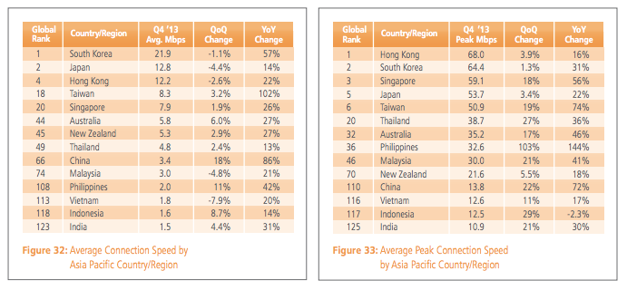
http://www.digitalspidey.com/wp-content/uploads/2014/05/akamai-soti-q413.pdf
http://www.digitalspidey.com/2014/05/akamai-state-of-internet-report-q4-2013/

Slide 20
2014

Slide 21
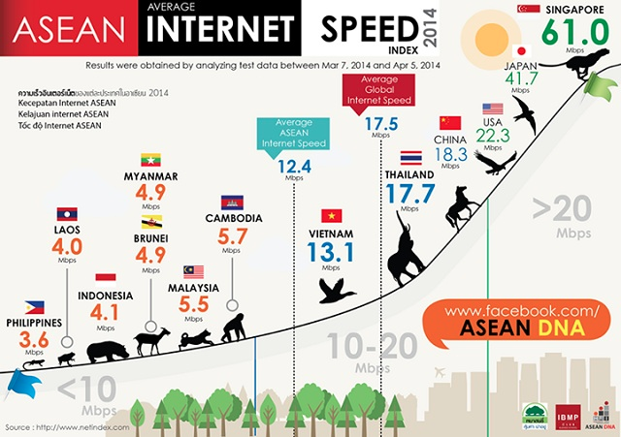

Slide 22
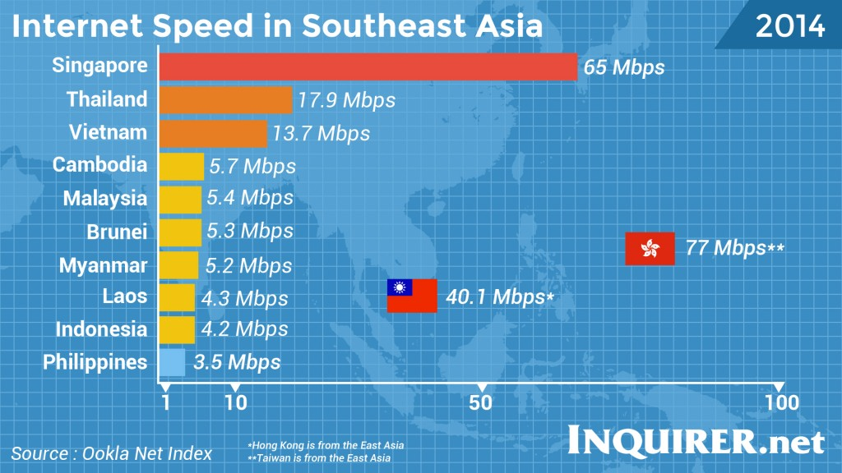
http://technology.inquirer.net/35871/govt-blamed-on-phs-slow-internet-speed

Slide 23
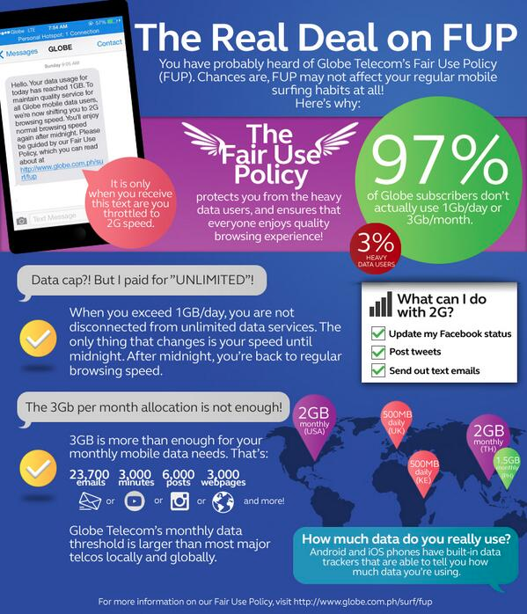
http://www.gmanetwork.com/news/story/347334/scitech/technology/phl-mobile-internet-users-abuzz-over-telco-s-data-cap-policy

